Slide 1

Social Engineering

Slide 2

01
What is social engineering
02
Why Social Engineering
Table of contents
03
Types of SE
04
Mitigation
05 Demo

Slide 3

01
What is Social Engineering

Slide 4


SE
is the art of manipulating people into performing actions of divulging confidential information. This technique manipulate human feelings, such as curiosity or fear to carry out schemes and draw victims into their traps.

Slide 5
Reconnaissance
Hook
Life cycle
Exit
Play
The attacker gathers information about the target, such as their name, job title, and contact information
The attacker establishes contact with the target and builds rapport.
The attacker achieves their goal and escapes without being detected
The attacker manipulates the target into performing a desired action, such as clicking on a malicious link or revealing

Slide 6

02
why Social Engineering

Slide 7

Them
Us
It is relatively easy
It is very effective
It is scalable……
According to Firewalltimes 98% of cyber-attacks in 2022 involves some form of social engineering.

Slide 8

03
Types of Social Engineering

Slide 9

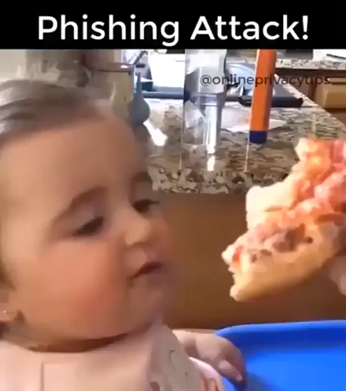
Phishing

Slide 10

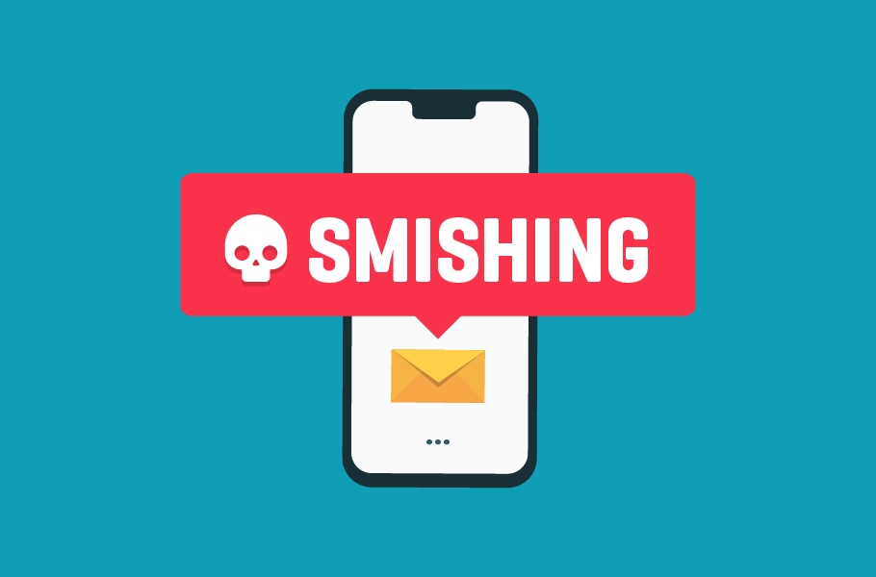
smishing
o text and instant messages faster than emailple respond people respond to text and instant messages faster than emailto text and instant messages faster than email

Slide 11
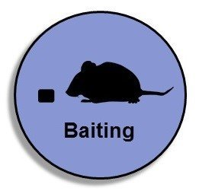
Baiting
Baiting uses a false promise to pique a victim’s greed or curiosity

Slide 12
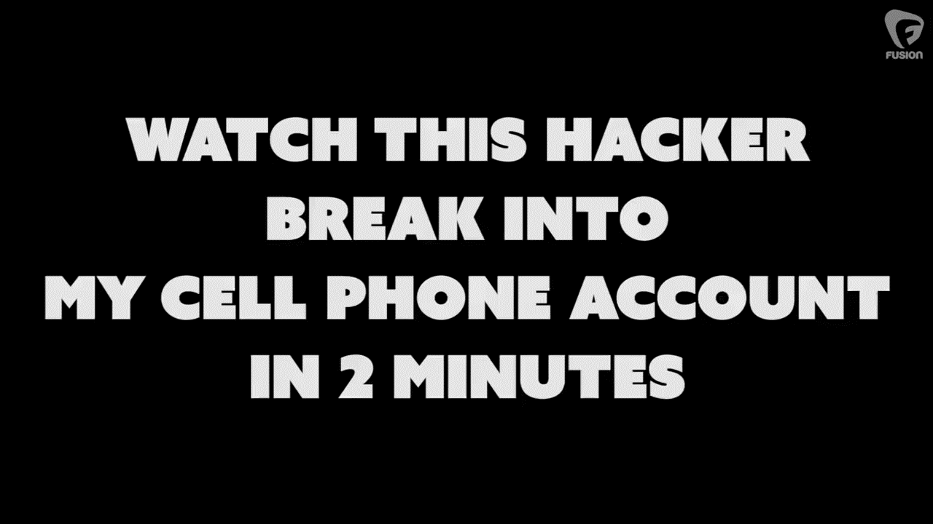

VISHING…

Slide 13
Scareware
In Scareware social engineering techniques, victims being bombarded with false alarms and fictitious threats.

Slide 14


Honey Trap
The perpetrator pretends to be romantically or sexually interested in the victim and lures them into an online relationship.

Slide 15

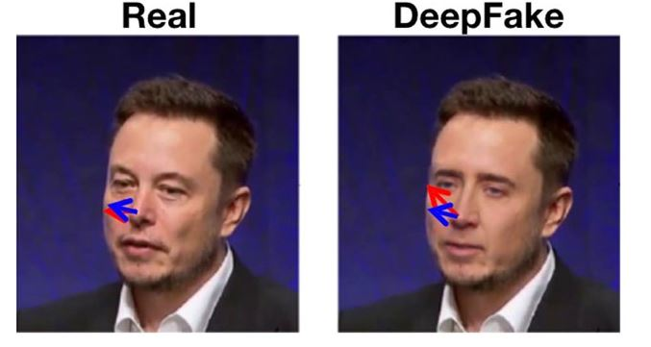
Deep Fakes
Deep fakes are synthetic media that have been digitally manipulated to replace one person's likeness convincingly with that of another

Slide 16
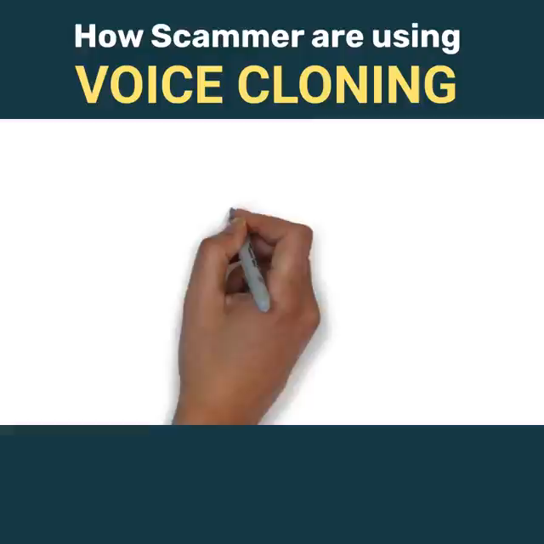
Deep Fakes

Slide 17

04
Mitigations

Slide 18
Mitigations
1 Educate the weakness, reward the positive
2 use technology to safeguard not as the savior
3 Actionable policies
4 Realistic Testing ....from the top down

Slide 19
Demo

Slide 20
Thanks
The End!!!

